Slide 1
Banking

Slide 2
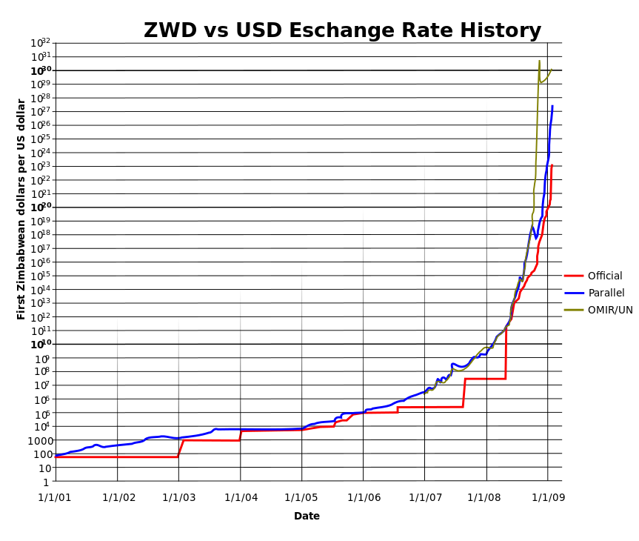
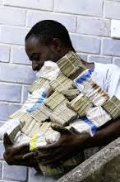
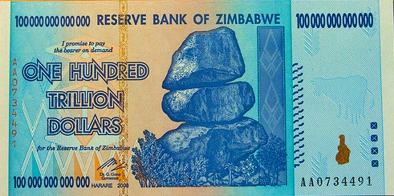

Slide 3
How a Bank gets its Money
Most start as a Corporation
Investors buy stock
Deposits from ppl & businesses

Slide 4
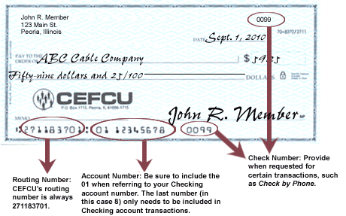
Banking Services for depositors
Checking accounts or DDAs
Debit cards take $ from Checking
Savings accounts and Time deposits
Savings accounts
Money Market accounts
Certificates of Deposit (CDs)
Credit cards
Electronic Funds Transfer (EFT)

Slide 5
What if the bank gets robbed or goes bankrupt?
FDIC (Federal Deposit Insurance Corporation)
NCUSIF (National Credit Union Insurance Fund)
Up to $250,000 per account

Slide 6
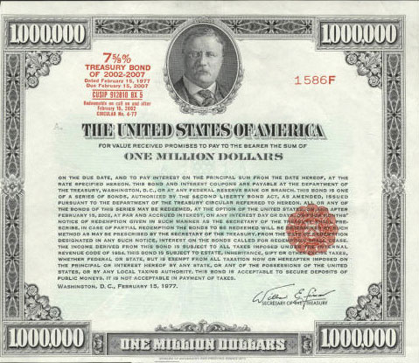
How a bank makes money
Loans
Auto loans, student loans, personal loans
Home Mortgage
Investments
Helping businesses issue stock
IPOs done by investment banks (Goldman Sachs, Credit Suisse First Boston, & Morgan Stanley)
Purchasing bonds
Fees
Page 292

Slide 7
Is your money actually sitting in a bank once you deposit it?
NO!
Fractional Banking system
Reserve Requirement
Required Reserves
Excess Reserves

Slide 8
How does a bank create money?
Simplified T-account for a bank
Assets Liabilities
Total Reserves: Demand Deposits (checking accts)
Required Reserves
Excess Reserves
Loans:
Securities:
Total: Total:

Slide 9
How does a bank create money?
Suppose you deposit $1,000 into your checking account.
If the reserve requirement was 10%...
Assets Liabilities
Total Reserves: DDAs (checking accts): $1,000
Required Reserves: $100
Excess Reserves: $900
Loans:
Securities:
Total: $1,000 Total: $1,000

Slide 10
How does a bank create money?
Now suppose Billy Bob borrows $900 to buy a car from Jimmy.
Assets Liabilities
Total Reserves: DDAs (checking accts): $1,000
Required Reserves: $100
Excess Reserves: 0
Loans: $900
Securities:
Total: $1,000 Total: $1,000

Slide 11
How does a bank create money?
Suppose Jimmy banks at the same bank as Billy Bob and deposits the money in his checking account.
Assets Liabilities
Total Reserves: DDAs (checking accts): $1,000
Required Reserves: $190 $ 900
Excess Reserves: $810
Loans: $900
Securities:
Total: $1,900 Total: $1,900

Slide 12
How does a bank create money?
Simplified T-account for a bank
Assets Liabilities
Total Reserves: Demand Deposits (checking accts)
Required Reserves
Excess Reserves
Loans:
Securities:
Total: Total:

Slide 14
Why this matters?
The more loans banks make, the more money is put into the economy.
What do you think happens when there is more money in circulation?
Inflation… who are the winners and losers?
So how can we control inflation?

Slide 15
Welcome to the Federal Reserve
The “Fed” is in charge of controlling our money supply (M1 & M2)
It is our central bank
But it isn’t exactly one single bank.

Slide 16
Monetary Policy: Three tools of the Fed to control the money supply
Raising or lowering the reserve requirement
Raising or lowering the discount rate
The discount rate is what it costs a bank to borrow money from the Fed
Buying or selling bonds

Slide 17
Assets Liabilities
Total Reserves: Demand Deposits (checking accts)
Required Reserves
Excess Reserves
Loans:
Securities:
Total: Total:

Slide 18
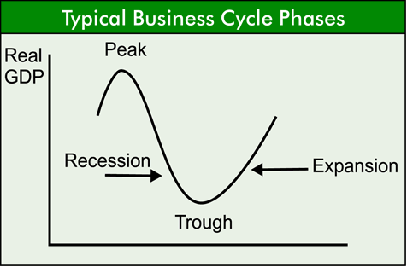
What if there isn’t enough money circulating in the economy?
Draw the business cycle.
In what part of the cycle would there not be enough money circulating?
In what part of the cycle would there to be too much money?

Slide 19
Does the money supply increase or decrease?
The Fed lowers the discount rate.
The Fed raises the reserve requirement from 10% to 15%
The Fed buys $1 billion worth of bonds

Slide 20
Monetary policy:
When should the Fed raise the supply of money in the economy?
When should the Fed lower the supply of money in the economy?

