Slide 1
Economics Basics
Continued…

Slide 2
What gives something value?
Utility & Scarcity
Goods:
Durable goods
Nondurable goods
Consumer goods
Capital goods
Services
A good or service has value when…..

Slide 3
Individuals & Societies have to answer the fundamental economic questions
What to produce
How to produce
For whom to produce
There is an opportunity cost for each choice
Op Cost is the value of the next best alternative not chosen
Translate that to normal English please

Slide 4
What’s the difference between income and wealth?

Slide 5
How do we tell if a country is “rich” or “poor”?
Gross Domestic Product (GDP)
Total value of all goods & services produced in a country in a year
GDP per capita
Factors of Production
Land
Labor
Capital
Entrepreneurs

Slide 6
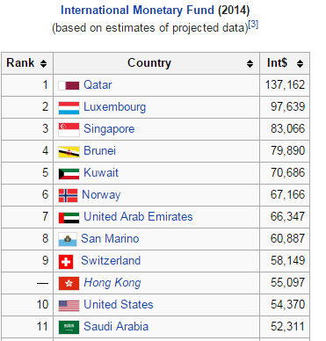

Slide 7
Everyone has to make choices.
Scarcity of resources forces choices
You can sleep or study, pack your lunch or buy it
But it usually isn’t an “all or nothing” situation

Slide 8
Imagine a typical school week
You could buy your lunch ever day or just a couple of days a week
This table is called a production possibility schedule.
Illustrates alternatives and opportunity cost
 | A | B | C | D | E | F
Buy | 5 | 4 | 3 | 2 | 1 | 0
Pack | 0 | 1 | 2 | 3 | 4 | 5

Slide 9
 | A | B | C | D | E | F
Buy | 5 | 4 | 3 | 2 | 1 | 0
Pack | 0 | 1 | 2 | 3 | 4 | 5
Let’s say you buy your lunch everyday and spend $5 for each meal.
How much are you spending each week to eat out?
But if you packed your lunch, that costs money too!
Loaf of bread - $2
Jar of Peanut Butter - $3
Jar of Jelly - $3
Bag of Chips - $4
5 Fuji apples - $5
That $28 over two weeks or $14 a week.

Slide 10
 | A | B | C | D | E | F
Buy | 5 | 4 | 3 | 2 | 1 | 0
Pack | 0 | 1 | 2 | 3 | 4 | 5
Life doesn’t have to be extremes
You could choose an alternative.
If you go from eating out everyday to only once, you are at alternative B.
What did you give up?
This is your opportunity cost!
What is your opportunity cost of going from C to E?
What is your opportunity cost of going from D to A?

Slide 11
Graph the schedule
 | A | B | C | D | E | F
Buy | 5 | 4 | 3 | 2 | 1 | 0
Pack | 0 | 1 | 2 | 3 | 4 | 5
You have just made a production possibilities curve

Slide 12
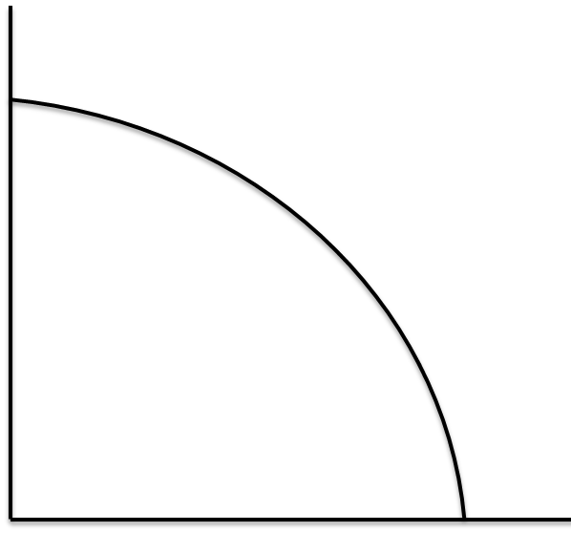
A Visual of an nation’s economy
Capital
Goods
(examples: machinery,
factories, buildings,
equipment)
Consumer Goods
(examples: clothes, cars, TVs)

Slide 13
Production Possibilities Table
 | Production Alternatives
Types of Products | A | B | C | D | E
Pizzas (in 100,000s) | 0 | 1 | 2 | 3 | 4
Cars (in 1,000s) | 10 | 9 | 7 | 4 | 0

Slide 14
Production Possibilities Curve
11
10
9
8
7
6
5
4
3
2
1
Cars
1 2 3 4 5 6 7 8 9
Pizza

Slide 15
Production Possibilities Table
 | Production Alternatives
Types of Products | A | B | C | D | E
Pizzas (in 100,000s) | 0 | 2 | 4 | 6 | 8
Cars (in 1,000s) | 14 | 12 | 9 | 5 | 0

Slide 16
Production Possibilities Curve
14
13
12
11
10
9
8
7
6
5
4
3
2
1
Cars
1 2 3 4 5 6 7 8 9 10 11 12 13 14
Pizza

Slide 17
PPC’s can shift
What might allow a producer to make more of a product?

Slide 18
Graph Practice
Assume an economy is economically efficient. Illustrate that an economy that is fully using its resources at its current level of technology.

Slide 19
Assume an economy is no longer fully employing its resources at the current level of technology. Illustrate this.

Slide 20
Illustrate an economy that is in a recession.

Slide 21
Suppose wages drop and the new lower wages discourage workers from seeking employment resulting in a decrease in labor participation rate.

Slide 22
Suppose that the capital stock used in the production of capital goods and consumer goods increases.

Slide 23
Suppose that because of a reduction of energy resources, an economy can no longer fully employ all of its technological advances.

Slide 24
Illustrate an economy that goes from a high level of unemployment to a more moderate level of unemployment.

Slide 25
Suppose an economy is fully-employed and the government imposes a mandatory retirement of 60 years of age.

Slide 26
Suppose an economy is using all of its resources efficiently and then increases its technology to produce more capital goods.

