Slide 1
From PPC to Circular Flow
With a pass through the business cycle along the way

Slide 2
Answer this question
How much control does the president have over the economy?

Slide 3
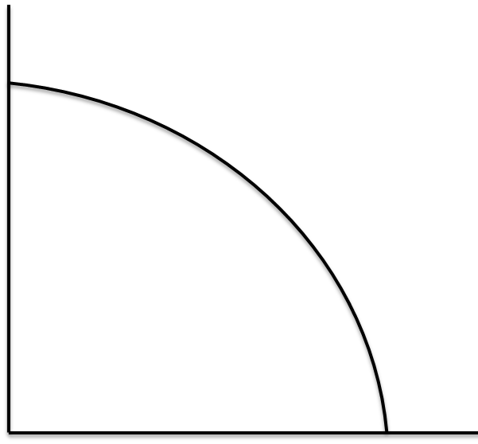
Production Possibilities Curve Multiple Choice

Slide 4
Business Cycle
GDP
Time

Slide 5
Types of Unemployment
Cyclical
Structural
Frictional
(Seasonal)
Say hi to most of the employees at Hawaiian Falls

Slide 6
Simple Circular Flow
Households
Firms

Slide 7
Simple Circular Flow + Gov’t
Households
Gov’t
Firms

Slide 8
Types of Economies
 | Traditional | Command | Market
Advantages | Sets forth certain economic roles for all members of the community Stable & predictable life | Capable of dramatic change in a short time Many basic education, health & other public services available at little or no cost | Individual freedom for everyone Able to adjust to change gradually Lack of gov’t interference Decentralized decision making Incredible variety of goods & services
Disadvantages | Discourages new ideas and new ways of doing things Stagnation and lack of progress Lower standard of living | Does not meet wants and needs of consumers Lacks effective incentives to get people to work Requires large bureaucracy, which consumes resources Little flexibility to deal w/ day-to-day changes Lacks room for individual initiative | Rewards only productive resources; does not provide for people too young, too old, or too sick to work Does not produce enough public goods such as defense, universal education, or health care Workers and businesses face uncertainty as a result of competition and change

Slide 9
Resource Ownership
Privately owned by individuals or business
What, How, For Whom:
Decisions made by private individuals & firms
Resource Ownership:
Determined by
tradition/community
What, How, For Whom:
Decision made
according to tradition
Resource Ownership:
Most resources owned
by the gov’t
What, How, For Whom
Most major decisions
made by gov’t

